Slide 1


GBME Probability and Statistics
Lecture 08
Lecture 08
Sampling
CHOONG-WAN WOO | COCOAN lab | http://cocoanlab.github.io

Slide 2
Lecture 08
Review: Key Points
Chapter 9 and 10: Regression wisdom, re-expressing data
Bends, subgroups, outliers
Cautious about extrapolation, causation, lurking variables, summary stats
Tukey’s ladder
CHOONG-WAN WOO | COCOAN lab | http://cocoanlab.github.io

Slide 3
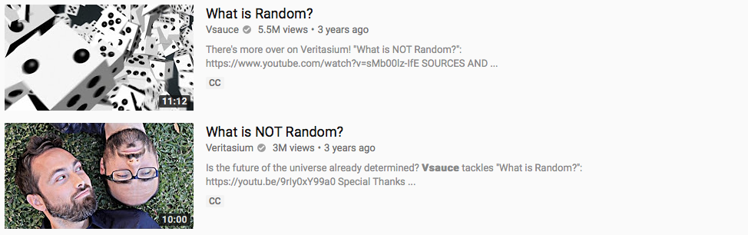
Lecture 08
Randomness
Good videos:
https://www.youtube.com/watch?v=9rIy0xY99a0
https://www.youtube.com/watch?v=sMb00lz-IfE
CHOONG-WAN WOO | COCOAN lab | http://cocoanlab.github.io

Slide 4
Lecture 08
Sampling
Idea 1: Examine a part of the whole
Population: the entire group of individuals
Sample: a smaller group of individuals, selected from the population
difficult to ensure the sample represents the population
Bias: over- or under-represent some characteristics of the population (e.g., Literary Digest Poll, they sampled response using phone calls when telephone was a luxury)
CHOONG-WAN WOO | COCOAN lab | http://cocoanlab.github.io

Slide 5
Lecture 08
Sampling
Idea 1: Examine a part of the whole
Idea 2: Randomize
To make sure the sampling is not biased
CHOONG-WAN WOO | COCOAN lab | http://cocoanlab.github.io

Slide 6
Lecture 08
Sampling
Idea 1: Examine a part of the whole
Idea 2: Randomize
Idea 3: Sample size matters
Important thing is not the fraction of the population, but the sample size.
Census: examine the entire population
It is difficult to complete a census
More noisy
They do not stand still
CHOONG-WAN WOO | COCOAN lab | http://cocoanlab.github.io

Slide 7
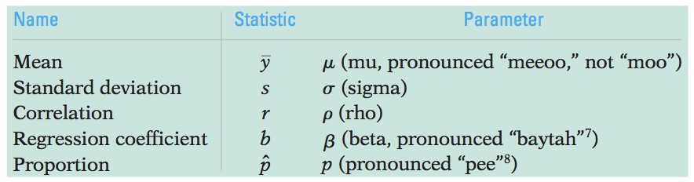
Lecture 08
Populations and parameters
Population parameters: parameters to model for a population
Sample statistics (or statistics): summaries of sample data to estimate the population parameters
CHOONG-WAN WOO | COCOAN lab | http://cocoanlab.github.io

Slide 8
Lecture 08
Sampling methods
Simple Random Sampling
Each person has an equal chance of being selected
Stratified Random Sampling
Strata: the population is first divided into homogeneous groups (e.g., male and female)
Then, simple random sampling within each stratum before the results are combined.
E.g., 60% men and 40% women in the campus: randomly sample 60 men and 40 women for 100 subjects
CHOONG-WAN WOO | COCOAN lab | http://cocoanlab.github.io

Slide 9
Lecture 08
Sampling methods (cont’d)
Cluster Sampling
Splitting the population into representative clusters, first.
Then, select one or a few clusters at random, and do census.
What’s different from stratified sampling? Clusters can be heterogeneous!
Multistage samples
combine several sampling methods
Systematic Samples
select samples systematically (e.g., survey every 10th person on the list)
CHOONG-WAN WOO | COCOAN lab | http://cocoanlab.github.io

Slide 10
Lecture 08
Common Mistakes in sampling
Mistake 1: Sample Volunteers: voluntary response bias
Mistake 2: Sample Conveniently: may not be representative of the population
Mistake 3: Use a Bad Sampling Frame: incomplete sampling frame introduces bias
Mistake 4: Undercoverage: some portion of the population is not sampled at all
Mistake 5: Nonresponse Bias: those who don’t respond may differ from those who do
Mistake 6: Response Bias: anything survey design that influences the response
CHOONG-WAN WOO | COCOAN lab | http://cocoanlab.github.io

Slide 11
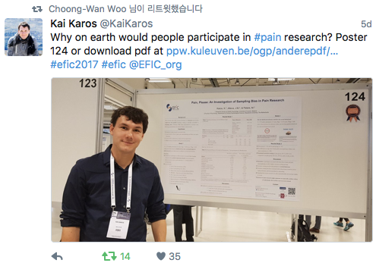
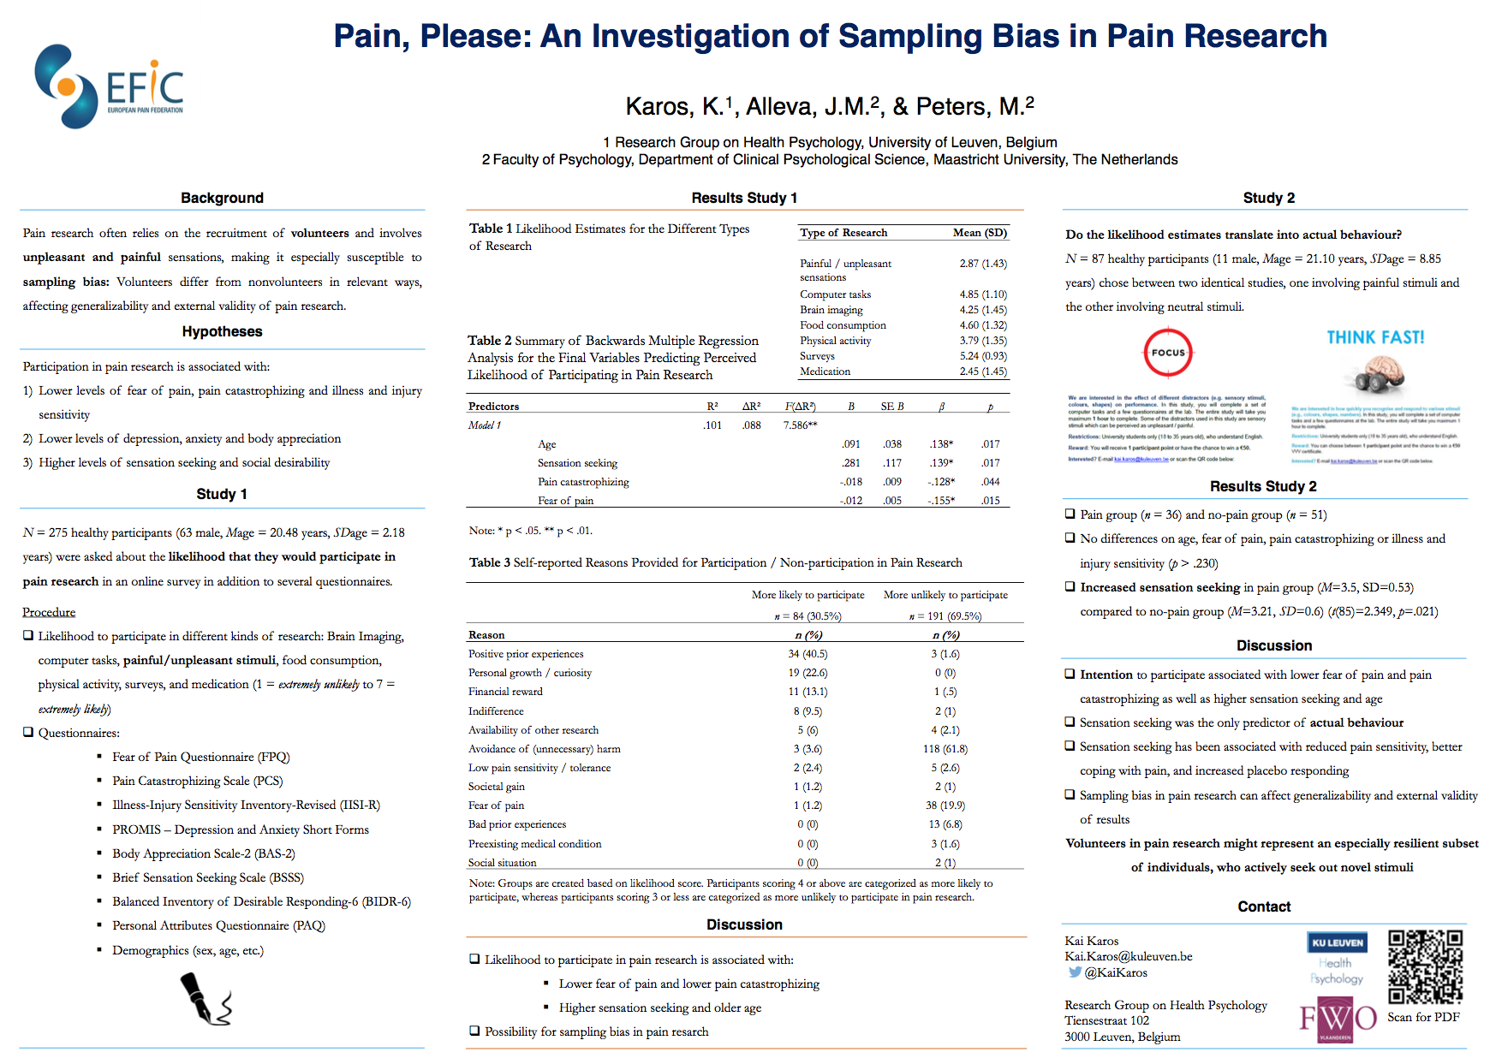
Lecture 08
E.g., Sampling bias in pain research
https://ppw.kuleuven.be/ogp/anderepdf/efic-2017.pdf
CHOONG-WAN WOO | COCOAN lab | http://cocoanlab.github.io

Slide 12
Lecture 08
Key Points
Chapter 11 and 12: Randomness, Sampling
Population parameters vs. sample statistics
Sampling methods:
Simple sampling, stratified sampling, cluster sampling, multistage sampling, systematic sampling
Common mistakes in sampling…
CHOONG-WAN WOO | COCOAN lab | http://cocoanlab.github.io

